Slide 1
Researching Family History: What Every Writer Should Know!
The Writers Center
September 18, 2024
Kenneth D. Ackerman
(202) 518-6379
kackerman@ofwlaw.com
www.KennethAckerman.com

Slide 2
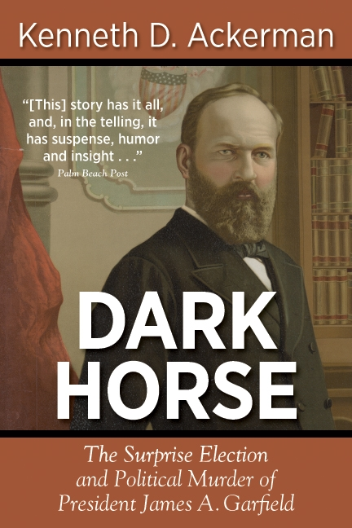
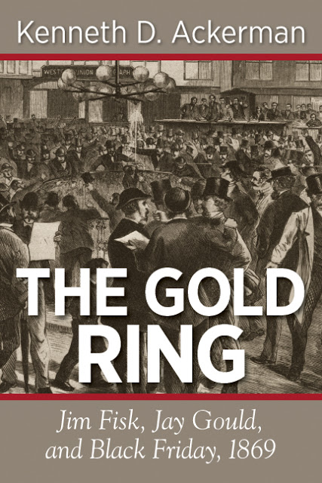
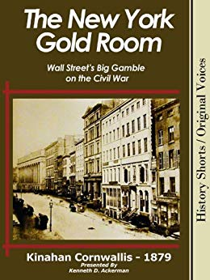
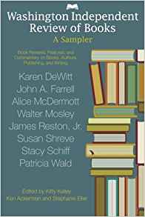
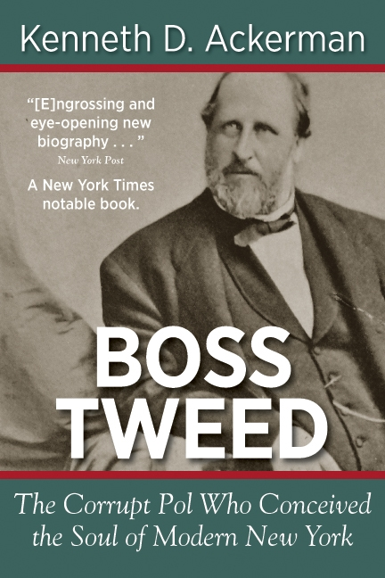
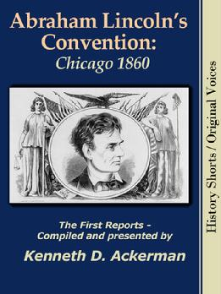

Slide 4
What We’ll Cover
Families: Some perspective.
Plan: What are you looking for.
The best source: People.
Next best: Papers, photos, and things.
Next best: Official documents, trolling online.
A word about DNA.
Organizing it all: Telling stories.
Resources:
Questions?

Slide 5
Nuclear or Immediate family: The “Building block of Society”

Slide 6
But families are changing:
Shrinking size:
2021 typical “nuclear family”: 3.13 people
Household: about 2.5 by some recent counts
1940 typical household 3.8 people, mostly two parents and children
1800s families typically had 10 or more children,
High infant mortality;
No effective birth control;
Economics (retirement fund)
Added complexity:
Divorces, adoptions, multiple marriages, same-sex couples, single-parent households, non-traditional families, more people living alone, so on.
Generations getting longer:
Typical age of mother at birth of first child-
In 1800s: late teens;
In 1971: 21.7;
In 2018: 26.9 years (30+ in large cities):

Slide 7
Families: Extended, Human
We each have 2 parents, 4 grandparents, doubles each generation:
Go back 5 generations (circa 120 years): 2 to 5th power = 32 direct
Go back 10 generations (circa 200 years): 2 to 10th power = 1,024 direct
Go back 20 generations (circa 400 years): 2 to 20th = 1,048,576
Each set of grandparents produces 5-10 children
Equates to hundreds of thousands of cousins, perhaps millions.
Within any ethnic or geographic group, we are literally all related.

Slide 9
2 x 2 = 2,028 x 2 =
4 x 2 = 4,096 x 2 =
8 x 2 = 8,192 x 2 =
16 x 2 = 16,384 x 2 =
32 x 2 = 32,768 x 2 =
64 x 2 = 65,536 x 2 =
128 x 2 = 131,072 x 2 =
256 x 2 = 262,144 x 2 =
512 x 2 = 524,288 x 2 =
1,024 x 2 = 1,048,576 x 2 =

Slide 12
Two more American challenges:
In America, we all come from someplace else
(Yes, even Native Americans):
Hard enough – Tracing roots in USA;
Harder – Tracing roots back across the ocean;
Different countries, different languages, fewer records.
But an opportunity: Good records on immigration.
For Black Americans – Legacies of slavery. Records.
Also in America, we get absorbed in the present:
We might humor older relatives, but often ignore them;
When they’re gone, it’s often too late to get their stories !!

Slide 13
Plan: What are you looking for?
Where do we come from?
Names and dates and relationships?
A particular story?
General background for children?
Examples:
Rachel
Ackermans
Danny
Ethel’s Tape
Ancestry family tree

Slide 15
To Start: Need names, dates, and facts As many as possible.
Best source: People
Interview your relatives – oral history
Connect with your siblings and cousins. Compare notes.
Get them to talk – Takes notes, or record if possible;

Slide 16
Interviewing parents: Basic biography facts
Start with facts and figures:
Names,
Dates,
Places,
Relationships.
Special care for non-traditional families:
Adoptions, divorces, single parents, remarriages, so on

Slide 17
Interviewing parents -- 2
What is your name? How is it spelled? Who were you named after?
When were you born? Where?
Did you have brothers and sisters? Names? Spellings?
Who were your parents? Names? Spellings? Where from?
Did they have brothers and sisters?
Where did you grow up? Where were you married? Circumstances?
If immigrants: When did you come to USA? Where from? Circumstances?
Key events in your life: School, jobs, accomplishments.
Are there any family documents: letters, diaries, records;
When was I born? Circumstances?

Slide 18
Get them to tell stories: Their voices. Their laughter. Their banter.
Favorite movies. Favorite music. Favorite places/vacations. Favorite people.
How did they fit into the world?
First vote? Kennedy v. Nixon? Military? Any criminals or communists?
But beware:
Some people don’t like to talk, especially about sensitive things;
Sometimes, people just don’t know. Or they forget. You need to prompt them;
And memories, even honest, are full of lies. (Even our own.)

Slide 19
Next best: Photos, personal papers, things.
Photos (get names, places, and dates)
Wedding book;
Tape recordings or videos (if you’re so lucky)
Personal letters
Diaries
Book notes
Certificates
Emails; Facebook posts & friends; Contact Lists.

Slide 20
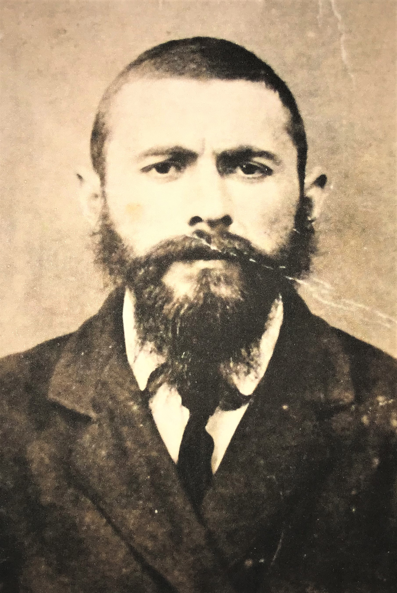

Slide 21
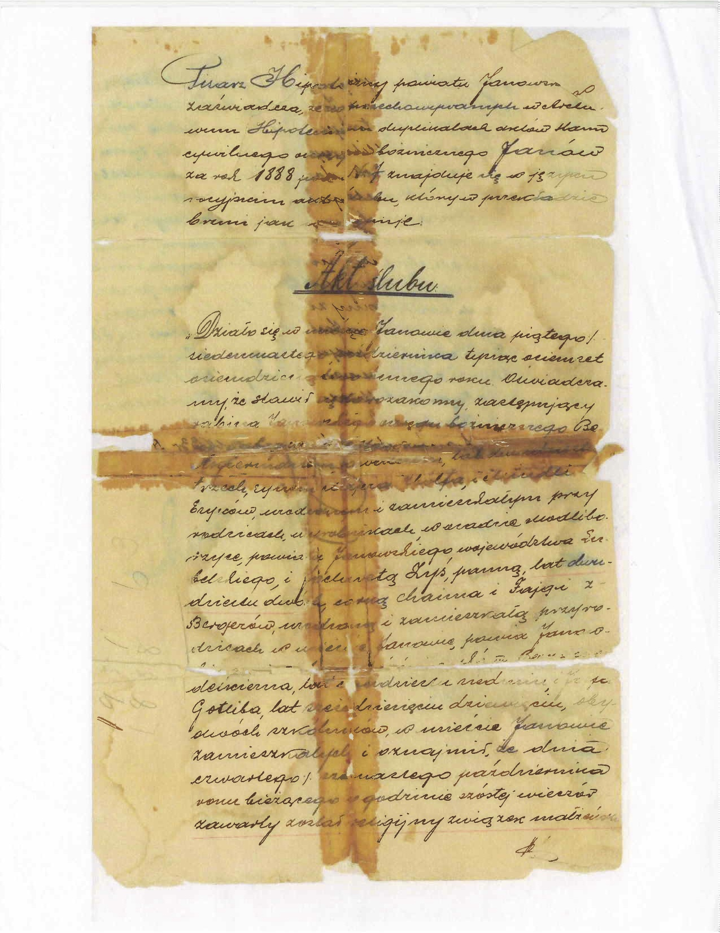
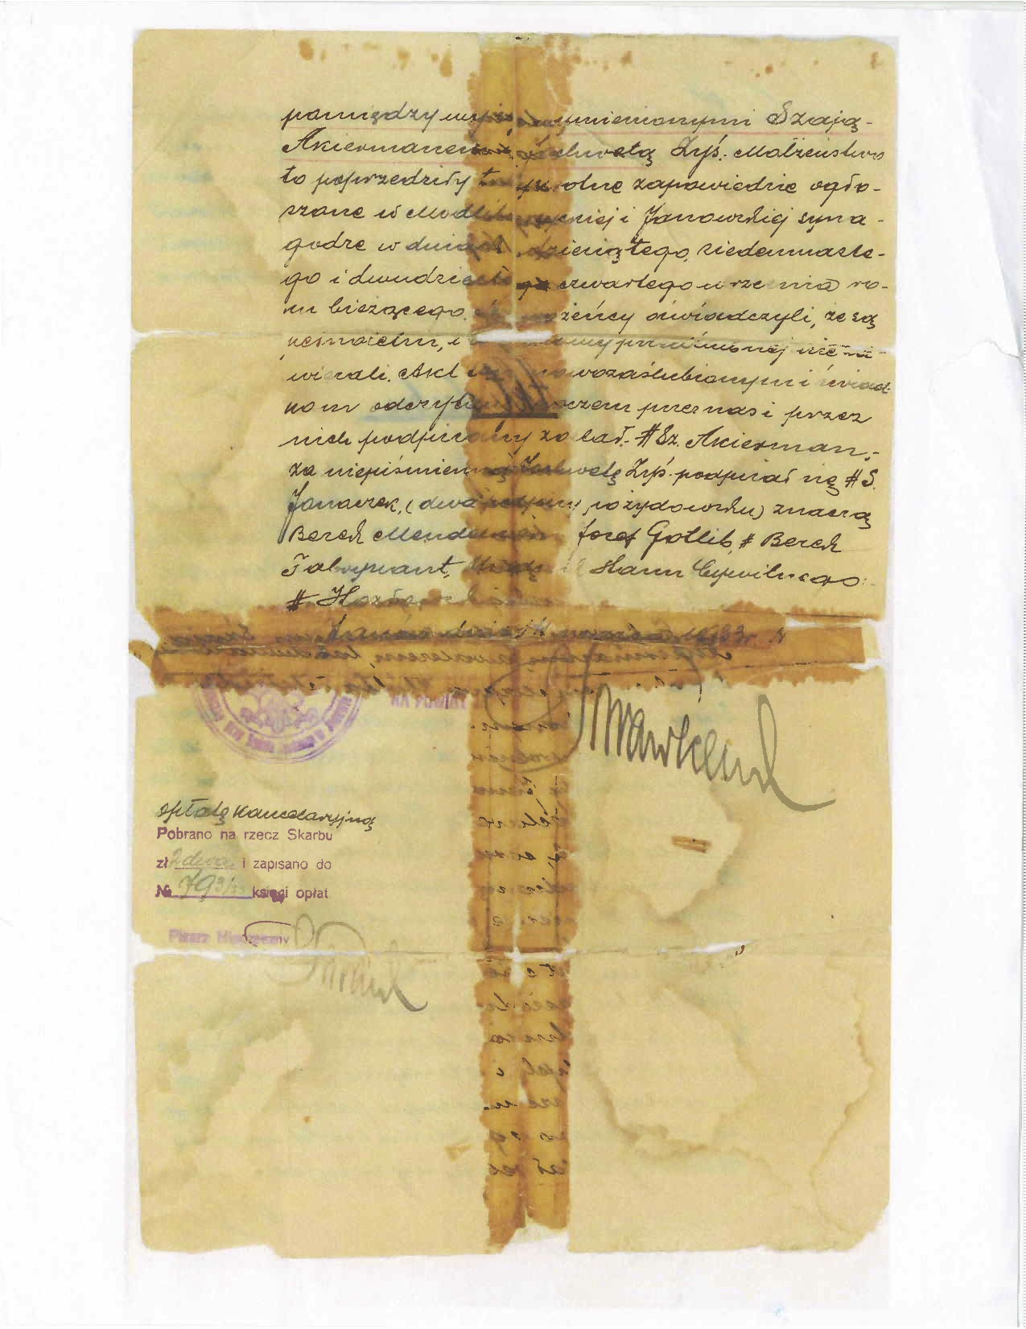

Slide 23
Documents: Trolling Online
Ancestry.com
Market value $4.7 billion (2020); over 3 million paying customers worldwide;
30 billion records; 18 million DNA kits
Immigration/Citizenship papers
Ship manifests
Bridges into the Old World
Census Records
Birth/Death/Marriage Records
Military records -- NARA and Fold3
Law Enforcement – FBI files
WWI era – online via Fold3 -- RG65, M1085
Newer – may need FOIA search

Slide 27
Bureaucracy, US Immigration:
1891: Commissioner of Immigration at Department of Treasury;
1903: Transferred to Department of Commerce and Labor;
1913: Transferred to newly-created Department of Labor;
1933: Functions consolidated in INS (Immigration and Naturalization Service) within Department of Labor;
1940: Transferred to Department of Justice;
2002: Transferred to new Department of Homeland Security.

Slide 28
Trolling online – 2:
To start: need names, dates, and place names
Beware of spelling: It changes over time!!
Think of all the ways your name can be misspelled!
Think of how it sounds in its original language!!
My name – Ackerman. In Yiddish: ֑אקרמך
This could be: ekermonn, aciermann, ochraman, akermann, ..
For Cyrillic, Arabic, Chinese, Korean, any other script, same issue
Before 1800, many people didn’t have actual last names;
William son of Robert. John the Blacksmith.
Look for specialized Ethnic/National Records

Slide 29
Special documents: Off to the archives
NARA:
Consular records, law enforcement, so on.
OPM personnel records: Saint Louis
Oral histories
Military records (but see Fold3, Ancestry)
DHS: Visa files Genealogy | USCIS
LC and online: Old newspapers and indices;
Local records: Birth and death certificates, land records, so on.
Foreign archives. (Often searchable online.)

Slide 30
DNA testing:
Largest:
Ancestry.com
23andMe.com
LivingDNA.com
I used Ancestry
Told my background based on database;
Connected to potential cousins
Crosschecked with large database
Consider
Ancestry plus health?
Protect your data?
Network with large database?

Slide 31
Groups:
Facebook and LinkedIn groups – Search by nationality:
Facebook:
Tracing the Tribe: https://www.facebook.com/groups/tracingthetribe/
Jewish Genealogy Portal: https://www.facebook.com/groups/JewishGenealogyPortal/
Linked In:
Jewish Genealogy: https://www.linkedin.com/groups/1917450
JGSGW- Jewish Genealogy Society of Greater Washington: http://www.meetup.com/JGSGW-Jewish-Genealogy-Society-of-Greater-Washington/
Washington, D.C. Family History Center:
Washington DC Family History Center | A Branch of the FamilySearch Library (wdcfhc.org)
Generations Newsletter, September 2022 (constantcontact.com)

Slide 32
Organize
Start with names and dates
Draw a map - Family Tree, as far back as you can
On Ancestry, you can share these
Build context
Youtube videos
Speedy aka Driving Around New York City 1928 Harold Lloyd and Babe Ruth - YouTube
Old newspapers

Slide 33
Resources: Online
Library of Congress: https://catalog.loc.gov/vwebv/searchAdvanced
NARA: http://www.archives.gov
Ancestry.com: http://www.ancestry.com
Ellis Island records: heritage.com
http://www.libertyellisfoundation.org/passenger
Fold3: https://www.fold3.com
Links by Country: http://www.heartwebsite.org/ResourcesAndLinks#Poland
JewishGen: http://www.jewishgen.org/JewishGen/
Jewish Gen Society Greater DC:
http://www.jewishgen.org/jgsgw/CurrentPrograms.html
Jewish Records Indexing (JRI) – Poland: http://jri-poland.org/jriplweb.htm
Polish National Archives: http://baza.archiwa.gov.pl/sezam/index.php?l=en
Polish Roots: http://www.polishroots.org
Routes to Roots Foundation: http://www.rtrfoundation.org/index.shtml
Virtual Shtetl: http://www.sztetl.org.pl/index.php?cid=17&lang=en_GB
DHS FOIA: http://www.dhs.gov/freedom-information-act-foia

Slide 34
Top Take Aways
- Living relatives, especially the older ones:
Get them talking while they can
Stories, facts, faces, places, people;
Get their laughs, their irritations, their smiles;
- Save the right things:
Left to own devices, people save junk and burn the good stuff.
Don’t let them!!!
- Hunt! Hunt! And hunt some more!!

Slide 35
Good hunting !!
Questions ?

