Slide 1
HIGH OCTANE GRAMMAR: Verbs, sentences, clarity, space, and humanity, to make your writing sing.
The Writers Center
October 16, 2024
Kenneth D. Ackerman
(202) 518-6379
kackerman@ofwlaw.com
www.KennethAckerman.com

Slide 2
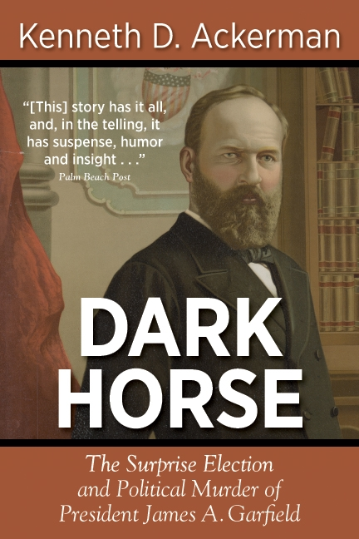
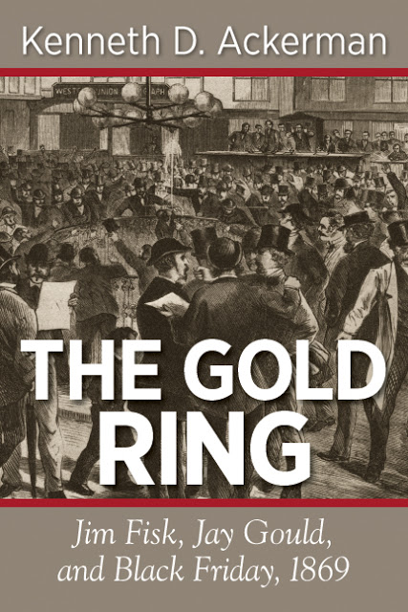
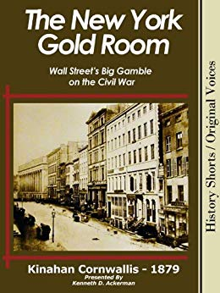
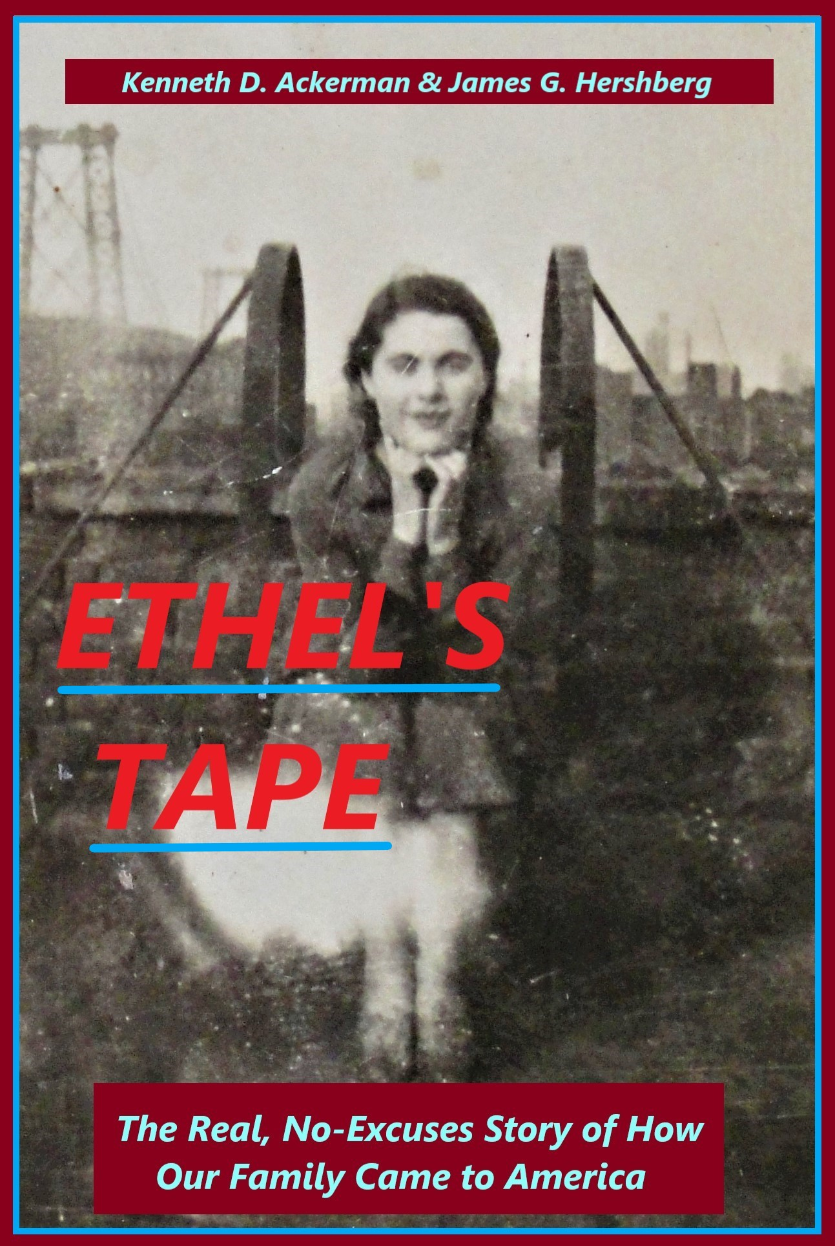
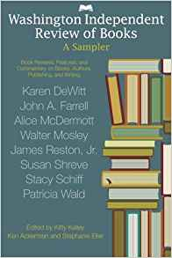
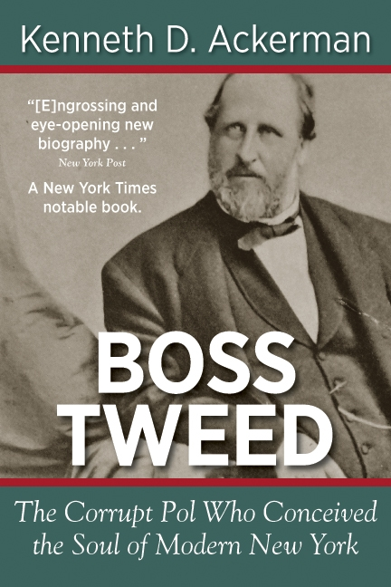
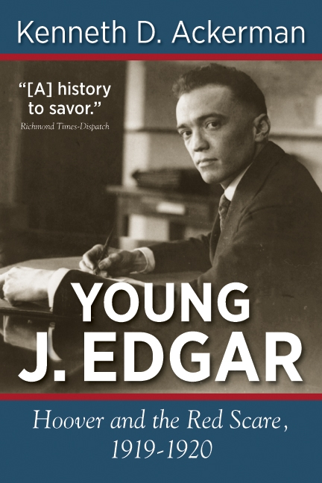
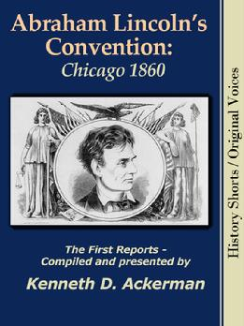

Slide 3
What We’ll Cover
Grammar: What’s the point?
Verbs: The most important words on any page.
Sentences, Paragraphs, Transitions.
Words: Too many, or in the wrong places.
Commas and quotes.
Examples: What great writing looks like.
Habits.
Questions?

Slide 5
Good writing:
When it’s good, you don’t notice it;
When it’s bad, it’s dense, stiff, confusing, and hard to read.
Goals:
Minimize friction;
Build pace, momentum, energy;
Convey information – facts, feelings, energy – seamlessly.
Hard for you, the writer,
Easy for me, the reader.
Like hockey.
But: Don’t let punctiliousness get in the way-
First drafts are for getting ideas on paper-
Second and third drafts are for making them sing!!

Slide 7
Verbs: Passive, Lazy, Weak
John walked the dog. (active)
The dog was walked. (passive)
The dog was walked by John. (passive)
The dog loved being walked by John. (active/gerund)
The dog permitted John to join him in walking. (active)
John was an aspiring writer. He was hungry for success. (Lazy)
John aspired to write. He yearned to succeed. (Active – better)
Tonight’s workshop was fantastic! (Simply true!!)
Ken’s rule: “Was” no more than twice per page !!
John coulda, shoulda, woulda walked the dog, but didn’t. (Conditional)
John would walk the dog. Did he?

Slide 8
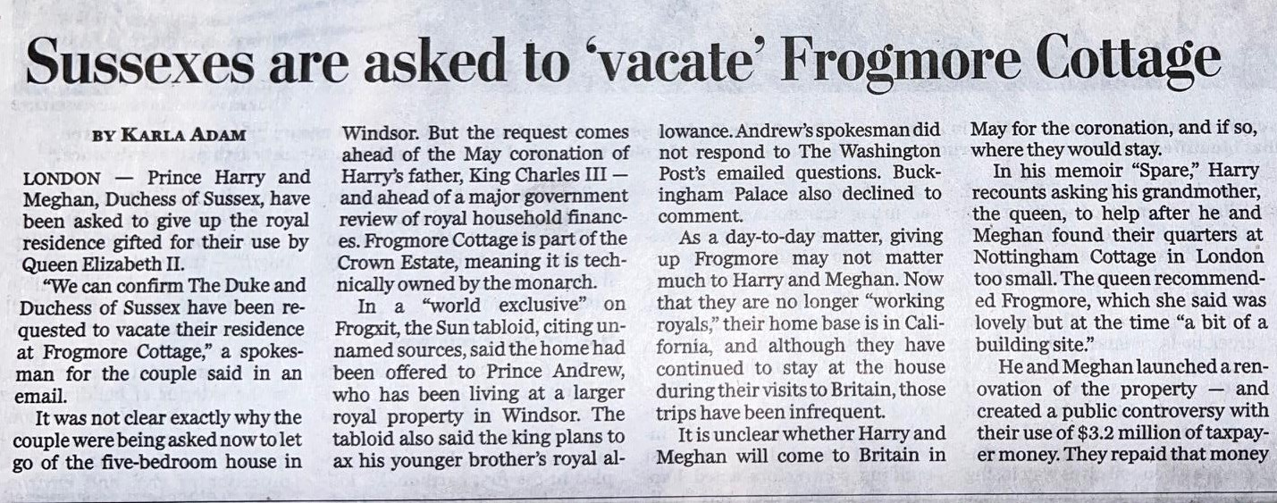
When passive voice should be used! NY Times, March 3, 2023

Slide 9
Tenses: When complex verbs should be used!
John was walking the dog but hadn’t finished yet. (past progressive)
had walked the dog long before dinner. (past perfect)
had been walking until he got home. (past perfect progressive)
John is walking the bog. (present progressive)
has walked the dog. (present perfect)
has been walking… (present perfect progressive)
will be walking the dog. (future progressive)
will have walked the dog (future perfect)
will have been walking… (future perfect progressive)
If John were to walk the dog, he would do it now. (subjunctive)
Afterward, John put to bed his walked dog. (past participle, an adjective)
He was tired of walking the dog. (gerund, verb as a noun)
He hated to walk the cat. (infinitive, verb as noun)

Slide 11
When can you violate all these rules?
Never by accident-
It punctures the flow of the writing;
Readers can sense something wrong;
And if they spot the specific error, you look sloppy.
But yes if-
It’s to make a point;
And you make it obvious that it’s deliberate –
So we’re all in on the joke.

Slide 12
Sentences, Paragraphs, Transitions All about pacing, readability.
Sentences set the rhythm. Short short long compound simple long.
Basic unit of thought:
Subject, predicate, object, modifiers.
Clauses: Independent; dependent (“even though”).
John walked the dog even though it was raining. John walked the dog; it was raining.

Slide 13
Long versus Run-On
Run-on sentence: two independent clauses, improperly connected:
The rain came down as John walked the dog he was thinking of putting the dog to bed.
The rain came down as John walked the dog. He was thinking of putting the dog to bed.
The rain came down as John walked the dog that he was thinking of putting the dog to bed.

Slide 16
How about this sentence?
Washington Post, June 20, 2024
Sports Section describing prior night’s Nationals game (vs Diamondbacks)-
“But after loading the bases before recording an out, Washington couldn’t have asked for more, limiting the damage to a Gabriel Moreno bases-loaded walk thanks in large part to a heads-up play by [Nasim] Nunez, who leaped for a line drive, watched it deflect off his glove, then gathered the ball and rifled it to the plate in time to nail Lourdes Gurriel Jr.”

Slide 17
How about this sentence?
“But after loading the bases before recording an out, Washington couldn’t have asked for more,
limiting the damage to a Gabriel Moreno bases-loaded walk thanks in large part to a heads-up play by Nunez,
who leaped for a line drive,
watched it deflect off his glove, then
gathered the ball and
rifled it to the plate in time to nail Lourdes Gurriel Jr.”

Slide 18
“But after loading the bases before recording an out, Washington couldn’t have asked for more. The team limited limiting the damage to a Gabriel Moreno bases-loaded walk thanks in large part to a heads-up play by Nunez, who leaped for a line drive, watched it deflect off his glove, then gathered the ball and rifled it to the plate in time to nail Lourdes Gurriel Jr.”
“But after loading the bases before recording an out, Washington couldn’t have asked for more, limiting the damage to a Gabriel Moreno bases-loaded walk thanks in large part to a heads-up play by [Nasim] Nunez. , who . Nunez leaped for a line drive, watched it deflect off his glove, then gathered the ball and rifled it to the plate in time to nail Lourdes Gurriel Jr.”

Slide 19
Paragraphs: Larger unit of thought.
Visual profile, one thought, one point-of-view (pov)
Topic sentences.
Use visual white space!
Chapters and Segments – Like cuts in a movie. Divide scenes.
Best transition often no transition. Foreshadow to next segment.
More use of visual white space!

Slide 20
Words: Too many.
They can become the enemy, each extra word a barrier for the reader.
John carefully and conscientiously walked the tired, hungry dog, first toward the park, then crossed the street at the corner, waited for the light to change, talked to other dog owners along the dreary street, until finally deciding to put the dog to bed and leading him the rest of the way home.
John walked the dog home. [Along the way, he first went toward the park, then crossed the street, and then talked with other dog owners until he decided to put the dog to bed.]

Slide 21
Words: In the wrong places.
John walked the dog wearing his red coat.
John, wearing his red coat, walked the dog.

Slide 22
Commas and Quotes
Commas:
Eats shoots and leaves. // Eats, shoots, and leaves.
Paris the capital of France, has the best food in Europe.
[Not: Paris – the capital of France – has the best food in Europe!]
Quotes:
Hanging quotes-
The Senator engaged in a “filibuster” because he “hated the bill.”
Its owner, John, said “I just walked the dog!”
“I just walked the dog,” said John, its owner.

Slide 23
Apostrophies
Possession:
Ken’s, Karen’s, America’s, the dog’s, the boys’ club;
Except pronouns: Mine, Yours, Ours, Its, His, Hers, Theirs.
Omission:
Contractions: Can’t, won’t, that’s, that’ re;
Class of ’99, the ‘90s.

Slide 24
Anchoring:
Point(s) of view: Appeal to common humanity
Characterization & motivation
Sensuality: Appeal to common experiences
Locale, shared memories
Sight, sound, taste, touch, smell
Anchoring: Appeal to common knowledge
He reached Europe six weeks after D-Day….
He started working on Capitol Hill three months after January 6….

Slide 25
Examples: What Great Writing Looks like
Kurt Vonnegut:
Woodward and Bernstein:
Alexander Solzhenitsyn:

Slide 26
Writing Habits
Journals and notebooks, capturing ideas.
First drafts and rewrites.
Edit edit edit …..
Security: Back up on a second computer, different place, or online.
On-going footnotes.
Talk with other writers!!

Slide 27
Bonus Page: Numbers
Democrats are more enthusiastic about investigating; they plan to issue more subpoenas.
They will devote many hours to the cause, and much enthusiasm.
Republicans were less enthusiastic and issued far fewer subpoenas.
The first day of hearings, Congressman Nadler called one witness, then five, then twelve, then twenty. The next week, he called 21, then 37, then 136.
Thirty-seven witnesses, you say? Yes, I said thirty-seven.
By the time Nadler finished, his Committee had heard 1,542 hours of testimony, or approximately (or about or circa) 1,500, or almost 1,600, or far fewer than 1,600, or far more than 1,400.
During Watergate, Senator Sam Ervin’s committee heard over 2,500 hours of testimony. Nadler had heard not even two-thirds as many hours, but almost two-thirds as many.
By contrast, Senator Carter Glass’s Banking Committee in the 1930s heard about 1,000 hours of testimony on Wall Street crash, fewer than either of the others. Senators back then got to the point.

Slide 29
Top Take Away
If you are going to obsess about anything-
Obsess over your verbs !!
Obsess over your white space !!
How does your writing look on the page?

