Slide 1
CONTRACTS & COPYRIGHTS
The Writers Center
October 11, 2023
Kenneth D. Ackerman
(202) 518-6379
kackerman@ofwlaw.com
www.KennethAckerman.com

Slide 2
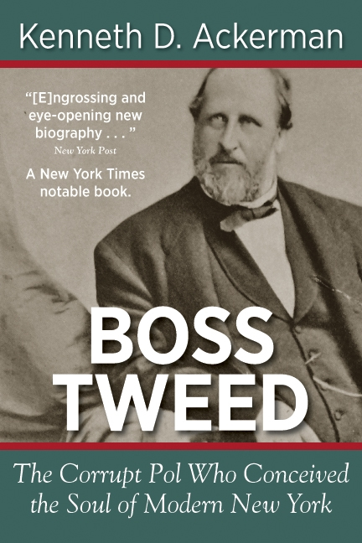
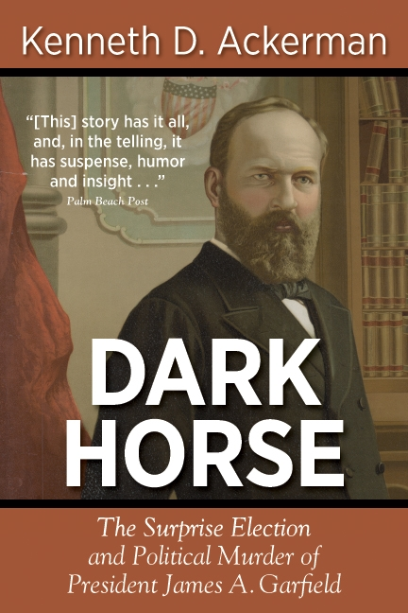
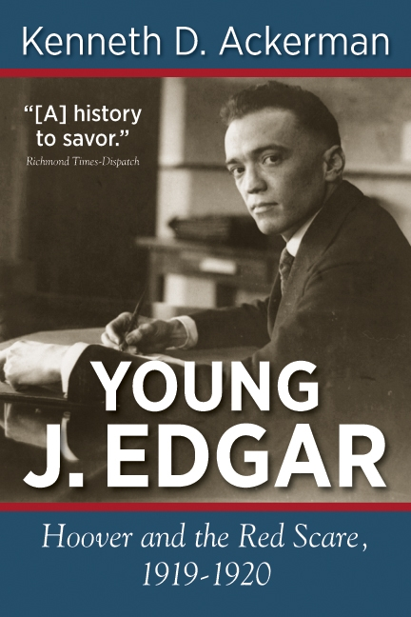
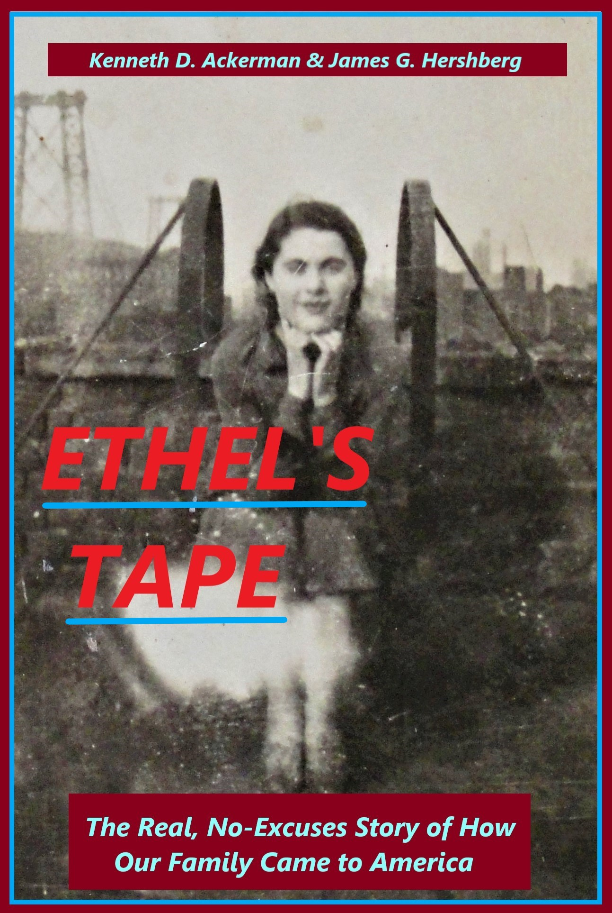
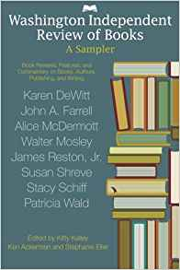
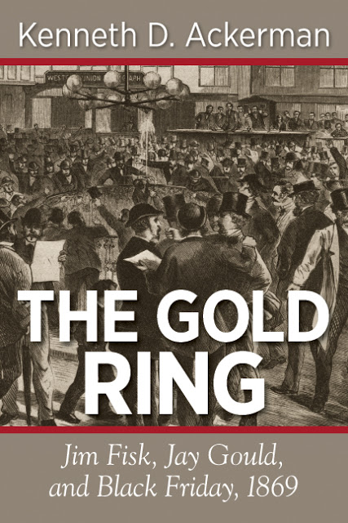
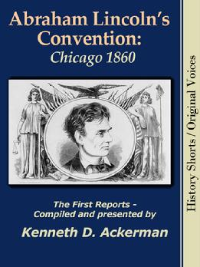
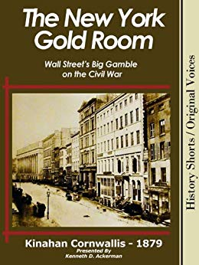

Slide 3
What We’ll Cover
What it means to be a “writer”
Who you sell to: Publishers
What you sell: Copyrights
How you sell: Contracts

Slide 5
Being an Independent Writer Means
Being a Small Business
With three functions
To Create: Articles, books, stories, ideas, screenplays, posts, poetry
To Sell: Either (i) outright, or (ii) limited use of your written work
To Manage: Things of value

Slide 6
Things of value:
Your Money;
Your Time;
Your Reputation;
Your Brand;
Your Things: notes, manuscripts, computers, phones, stuff;
Your Self (health, education, sanity);
Your Creativity;
Your Contacts (friends and business associates);
Your Balance;
Your Risks.

Slide 7
The Basic Writer’s Tradeoff
You create written works
Your control/ownership of them is an asset
They have value –
To realize this value (monetize), must sell to “publisher”
(1) Distribute it (2) to other people (3) in final form (4) for gain.
Or be the publisher yourself !!
You (the writer) must give them (the publisher) the right to use your work
In return, they give you benefits / compensation
You can get paid -- Money !!
You can get noticed – Exposure !!
You can get read – Expression !!

Slide 8
What publishers do?
Produce the book (or magazine, blog, website, so on)
Editorial
Graphic design and layout
Printing and materials or digital production
Distribute it
Get the book into stores and onto Amazon.com
Get the magazine to subscribers, onto newsstands or on-line
Handle sales and financial cash flow
Market and publicize it
Get reviews, arrange media coverage, store shelf space, books tours
“Marketing Muscle” and “branding”

Slide 9
Types of Publishers
Book publishers-
Commercial presses
Academic presses
Small or specialized presses
Yourself
Magazines, Newspapers, print or online
Blogs, websites, podcasts
Social media – Facebook, Instagram, Twitter
Radio, TV, film, documentaries.
Basic rule:
None can survive without you, the content creator!!
The more outlets you work with, the better-
More variety
More choices –

Slide 10
Often your best publisher -- Yourself
Forms of self-publishing
Website
Blog
Social media: Facebook, Instagram, Twitter, LinkedIn, TikTok
YouTube
Actual books -- Contract with Amazon et al for distribution
Key advantage: Control and Immediacy!!
Sometimes, not always, you can get paid for it-
But that’s not always the main point –
Exposure and Expression

Slide 12
What You’re Selling - Copyrights
U.S. Constitution, Article I, Section 8 –
“The Congress shall have the power…To promote the Progress of Science and useful Arts, by securing for limited Times to Authors and inventors the exclusive Right to their respective Writings and Discoveries.”

Slide 13
What You’re Selling – Copyrights United States Code, Title 17– Federal Copyright law
With copyright, you own the exclusive right to:
Produce and distribute copies of the work;
Produce derivative works;
Display and perform the work.
Covers music, art, design, as well as text.
For a book, the whole package:
Cover, images, interior layout, index, design, organization, plus text.
You own it instantly, upon its creation. (Common Law Copyright)
Unless you produced it under contract as “work for hire”
Copyright registration (LC) provides evidence, warning, and better damages.
But it is not necessary to establish rights!!
www.copyright.gov

Slide 15
Copyrights – What You Sell
Copyright is a package
Can be broken into parts, each part sold separately
First serial rights: Publish for the first time
If no written contract or contract is vague, this is the default
New York Times Co. vs. Tasini et. al. (2001)
Second serial (reprint) rights
Non-exclusive rights
Subsidiary rights: other than the book itself
Performance rights (film, stage, TV), Audio Book, documentary, book club, so on.

Slide 16
Exceptions
The work must be
Original by the author or creator,
Fixed in tangible form – not just an idea,
Not a title or short phase (trademark),
Not composed entirely of public information.
It must not be “work for hire”
Prepared by employee in scope of employment
Specifically ordered or commissioned. (Read the contract!!)

Slide 17
Chord patterns for songs – mixed results:
My Sweet Lord, by George Harrison / He’s So Fine, the Chiffons
Suit won, “subconscious plagiarism” ; Harrison forced to pay $1.5 million in earnings
Thinking Out Loud by Ed Sheeran / Let’s Get It On by Marvin Gaye
Suit lost – case dismissed ; Judge: “the chord progression and harmonic rhythm … are so commonplace … that to protect their combination would give … an impermissible monopoly over a basic musical building block,”
Artificial Intelligence (AI) cases:
Work (art or writing) generated entirely by AI
No protection – no human authorship
If edited or updated by humans – can be protected if enough human involvement
Hence Hollywood studios need screenwriters to collaborate with AI for protection
Use for copyrighted books for training AI chat boxes?
Being actively challenged

Slide 18
More Exceptions
It doesn’t last forever-- rule of thumb: 1927
Post January 1, 1978: life plus 70 years
Pre-1978: 75 years
If active on October 27, 1988, add 20 more years - Sonny Bono Act
Protected Mickey Mouse until end of 2019
All works are subject to “Fair Use.”
Use of small excerpts for criticism, news, teaching, scholarship, satire, so on
Courts look at purpose (commercial v. educational), amount, nature of work, & impact on value.

Slide 19
Copyrights also create Obligations -
Don’t steal from other people !!!
Physically “having” something does NOT give you the right to use it!!
It’s easy to copy photos from the internet, but you are liable for using them!!
Ignorance is no excuse !!
Penalties:
Actual damages or
“Statutory damages”: $750 up to $30,000; $150,000 if willful; or
Criminal penalty: up to 5 yeas in jail if “willful” and retail value above $2,500.
CASE (Copyright Infringement Small-Claims Enforcement) Act of 2020
Created the Copyright Claims Board, a special small-claims tribunal for fines up to $15,000 per infringement, $30,000 per claim. www.ccb.gov
Beware of “copyright trolls”
Permissions (required unless “public domain” or “fair use”) ;
Attributions (even if public domain) to avoid plagiarism claims.

Slide 20
How You Sell Them - Contracts
Yes, they are binding.
Yes, they are literal. They mean what they say.
Hence the long, tedious, dense clauses and subclauses.
Yes, they can be changed, but only by mutual consent.
They can take different forms
Common law: offer, acceptance, and mutual obligations
Theoretically, can be oral--
But: Always get it in writing
Statute of Frauds (UCC) – Generally $500+ must be in writing
Avoids honest mistakes, provides clarity and evidence
Includes any amendments, extensions, modifications, so on
Can be simple: Exchange of E-mails or letter of confirmation
Or a long document written by lawyers with lots of clauses

Slide 21
Typical Contract Terms
Your promise to deliver
Deadlines (penalties), materials, length, graphics;
Their promise to publish
(Thus, for instance, kill fees for magazines.) Time frames;
Division of rights
Reprint, subsidiary (film, dramatic, audiobook), exclusivity, limitations, so on;
Payment terms, for books;
Royalties and/or fees;
Advances against royalties;
Size & Payment Schedule
Generally stated as either (i) percent of retail price or (ii) “net proceeds”
Warranties
Authorship/plagiarism, copyright/permissions, libel/slander, obscenity, privacy, so on;
Option on next work/multi-work packages.

Slide 22
Most Important Rule About Contracts
ALWAYS read them!
If you don’t understand -- ASK someone!!

Slide 23
The Writer’s Lawyer: Essential Legal Advice for Writers and Editors in All Media, by Ronald L. Goldfarb and Gail E. Ross
Copyright Discussion Group | Association of College & Research Libraries (ACRL) (ala.org)
Copyright Questions - Copyright Advisory Network (librarycopyright.net)

