Slide 1
Emma Goldman: The Jewish Rabble Rouser
Congregation Etz Hayim
November 8, 2023
Ken Ackerman
kackerman111@gmail.com
www.KennethAckerman.com

Slide 7
Emma in Russia, 1882, standing on left

Slide 16
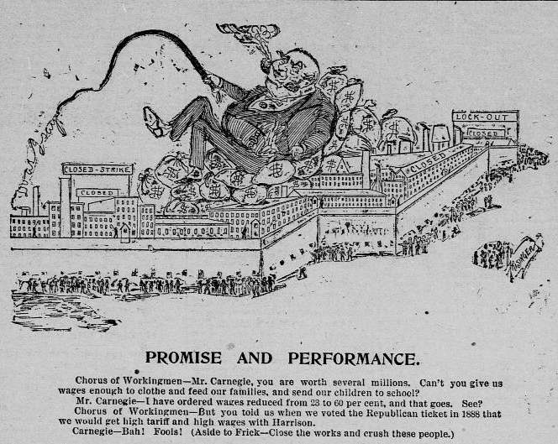

Slide 17
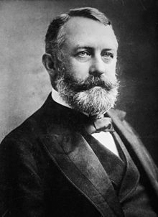

Slide 18
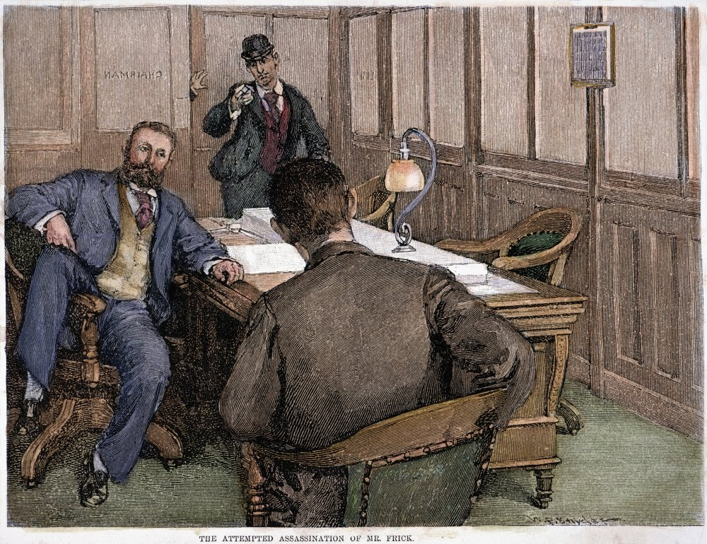

Slide 24
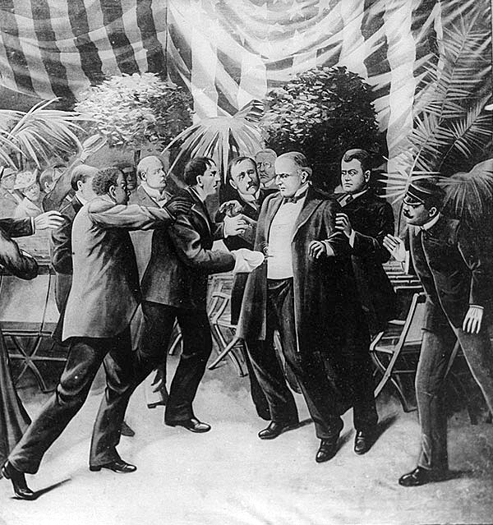

Slide 31
“Emma Earns Her Punishment” 2/16/1916 Sweat Shop Boss while she preaches birth control

Slide 36
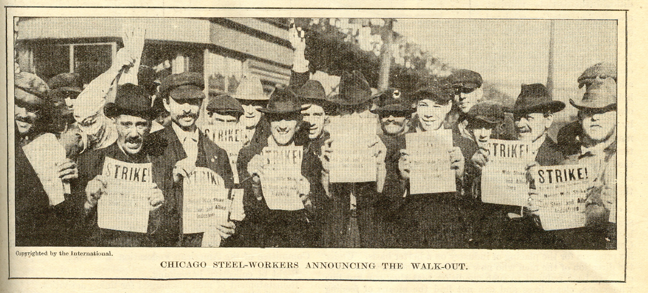
Red scare photos

Slide 37
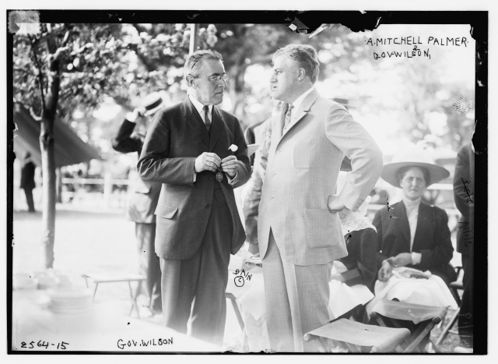

Slide 46
Russia 1917

