Slide 1
Albert and Benjamin Cardozo: A Jewish American family drama
Kenneth D. Ackerman
kackerman111@gmail.com
www.KennethAckerman.com

Slide 4
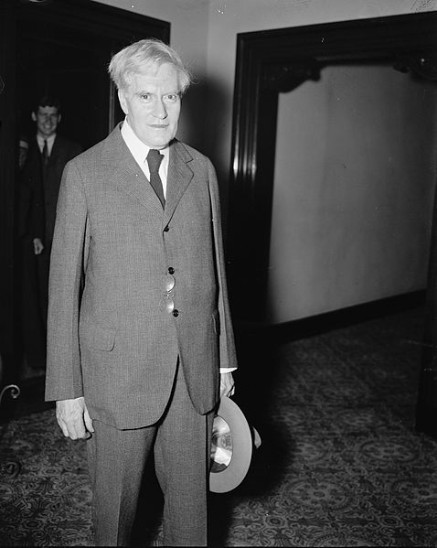

Slide 5
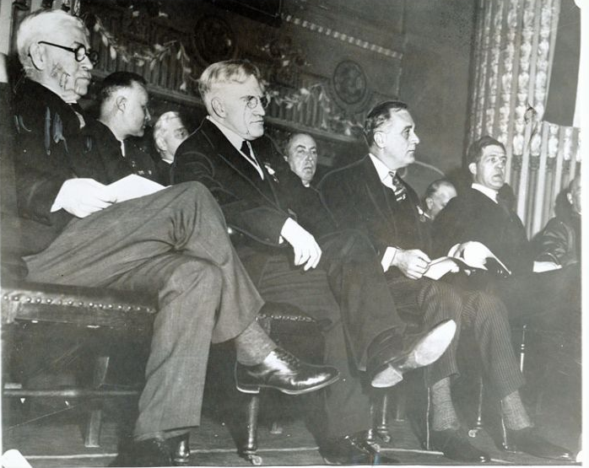
1

Slide 7
2.

Slide 9
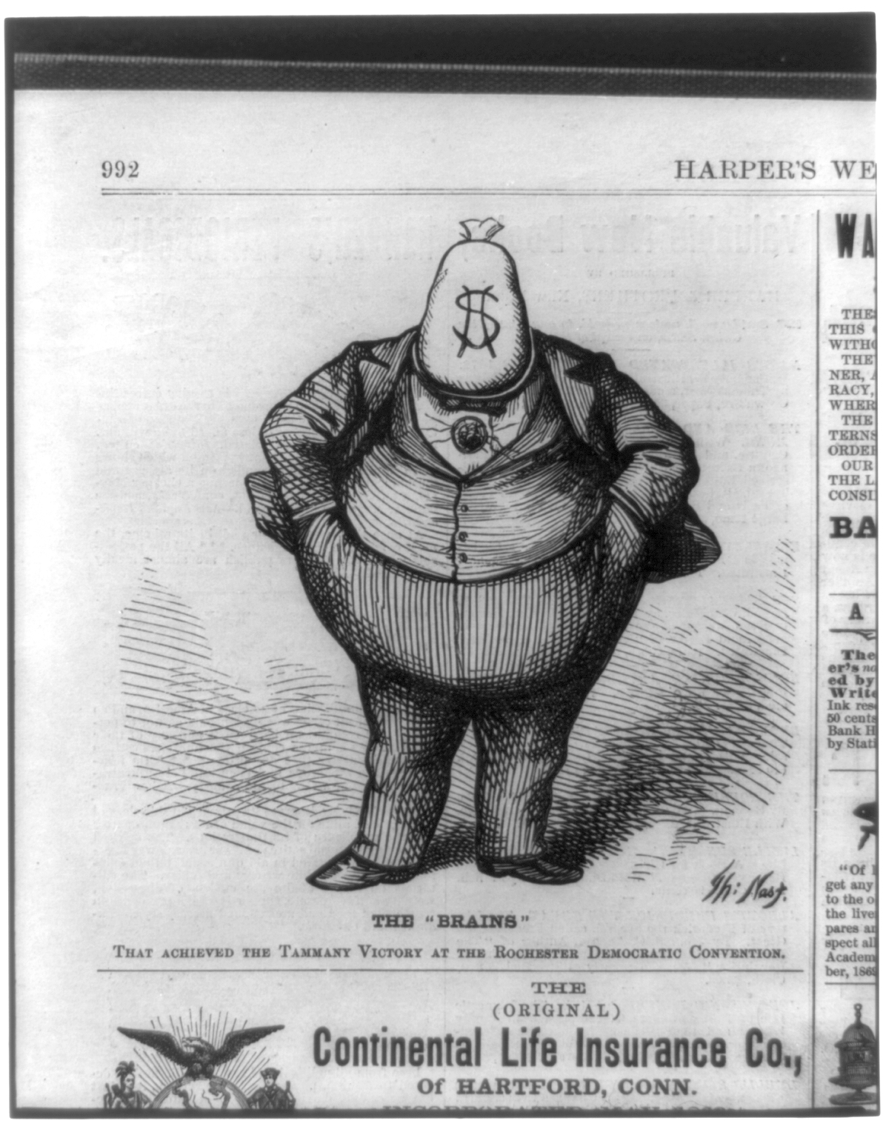

Slide 10
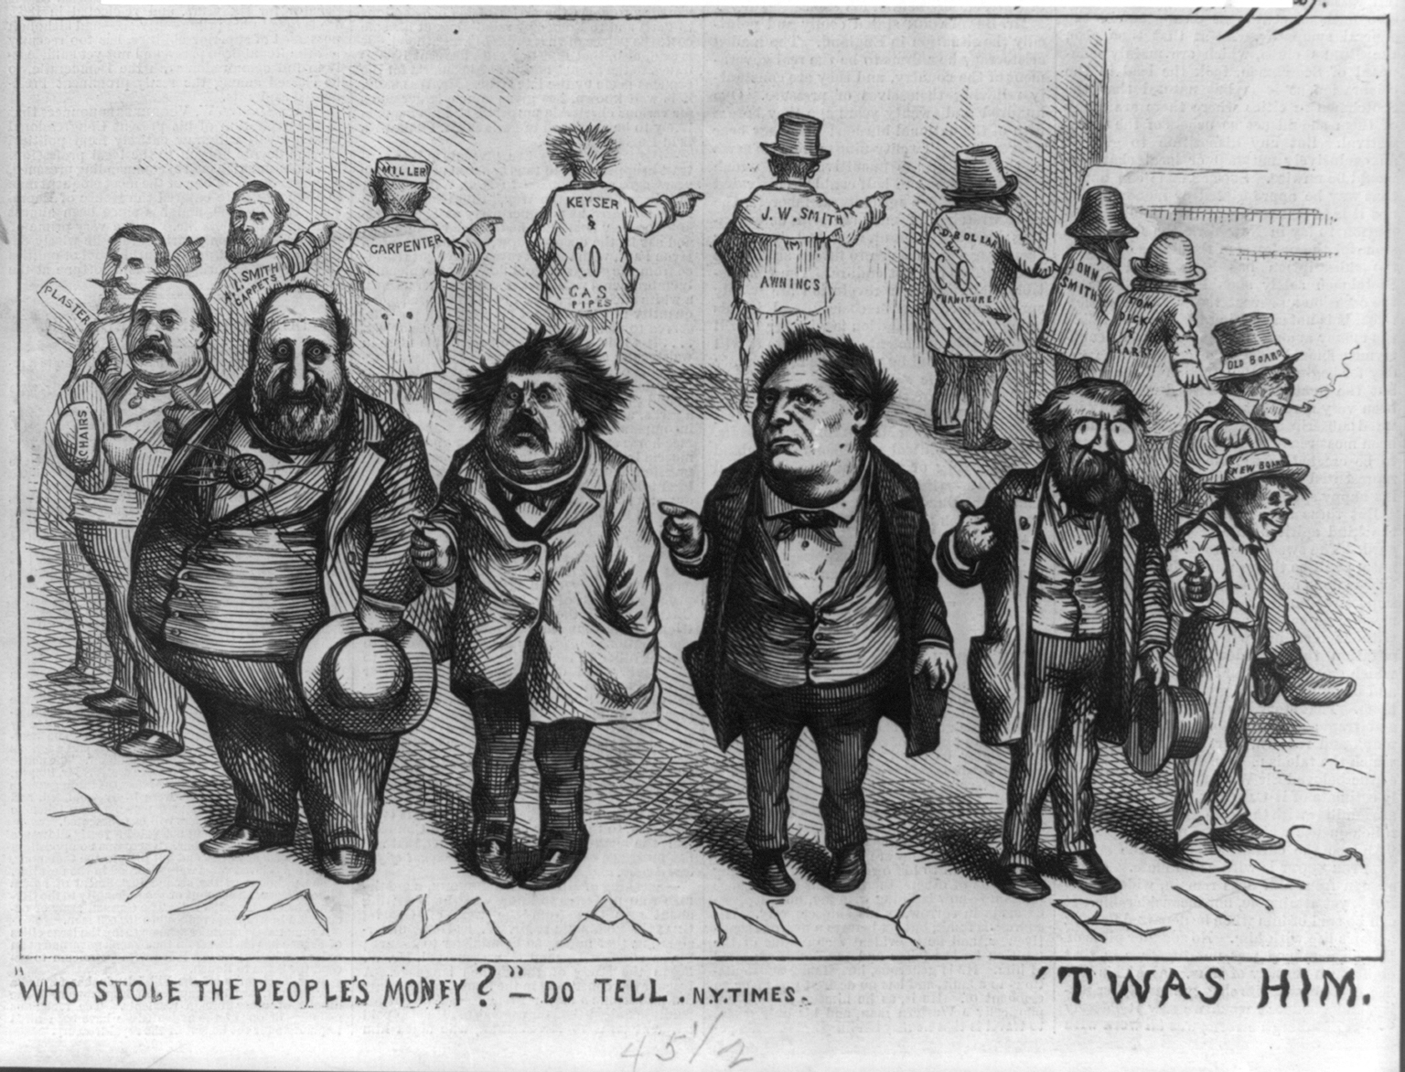

Slide 11
3.

Slide 13
“… He is particularly gifted as a speaker. His speeches are marked by conciseness of language, closeness of reasoning and practical good sense. … He is withal a gentleman of cultivation and elevated social relations.” New York Leader, October 17, 1863
“His features had a slight Hebrew cast; his face was beardless and his complexion almost livid; he wore long, thick curly hair but his eye was his most market feature. It was black, piercing, and ever alert. A bitter opponent once said that he had the eyes of a serpent looking from the face of a corpse.” Charles Wingate, North American Review, October 1874.

Slide 14
“Judge Cardozo is a very different man from Judge Barnard. Courteous
but inflexible, subtle, clear-headed, and unscrupulous, this magistrate
conceals the iron hand beneath the silken glove."
Charles Francis Adams, North American Review, A Chapter of Erie, July 1869
Barnard and Cardozo are known as “slaves of the ring.”
Henry Adams, Chapters of Erie, October 1870.

Slide 15
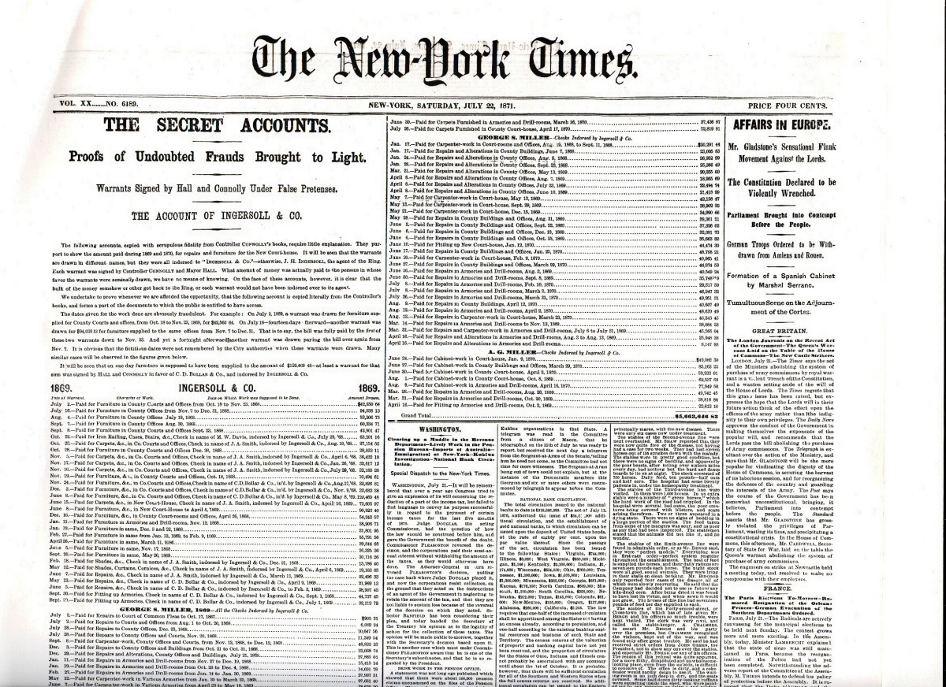

Slide 16
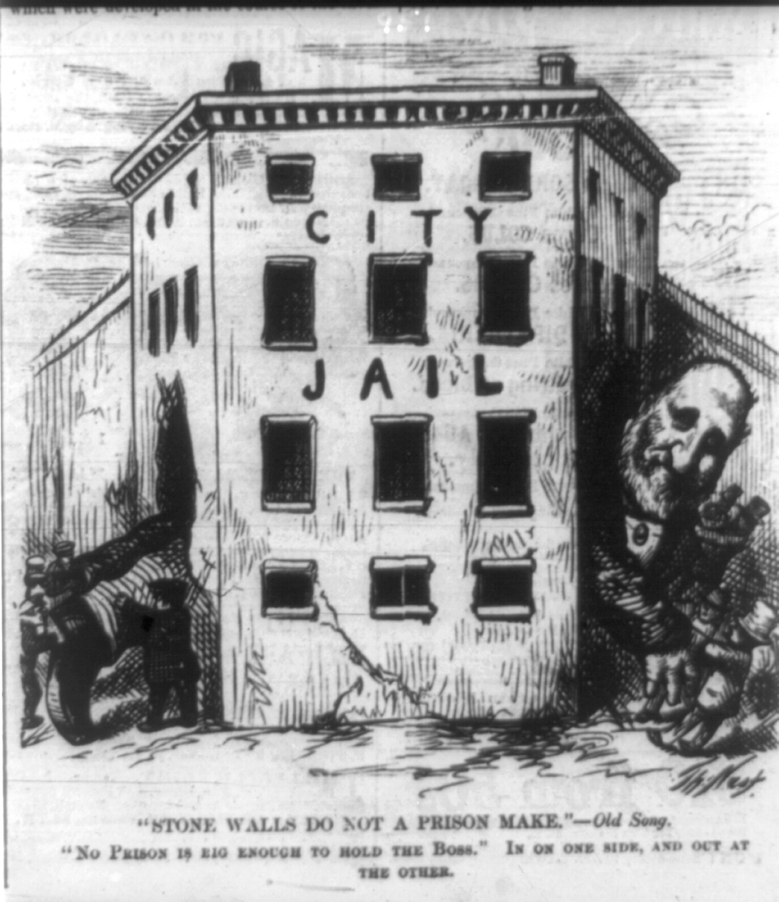

Slide 17
4.

Slide 18
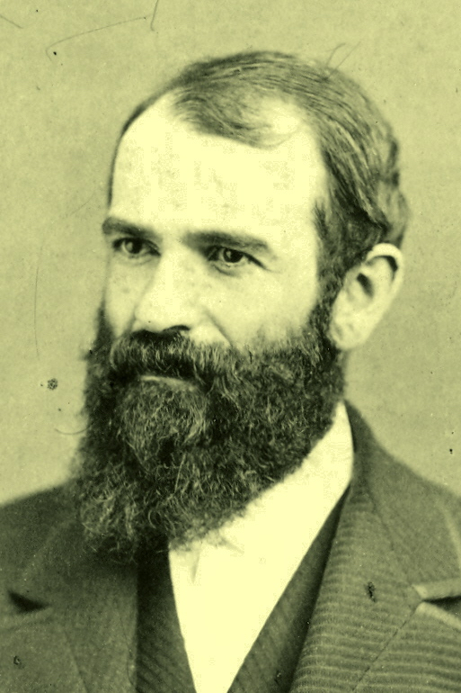

Slide 19
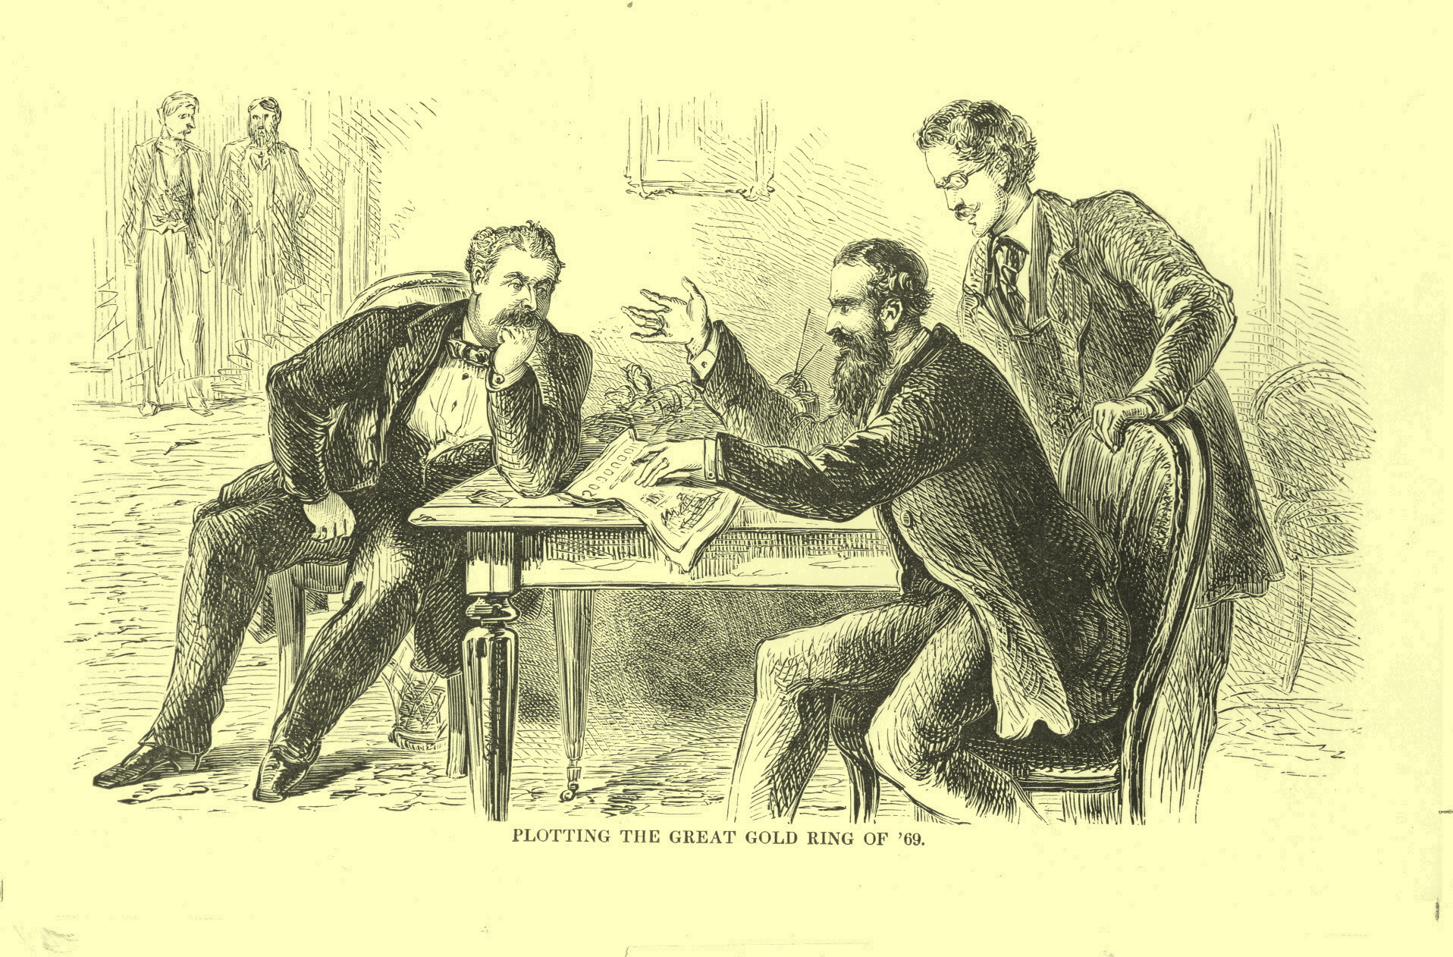

Slide 27
Benjamin, born May 24 1870
He and twin sister were youngest of six children
Father: Albert Cardozo
VP of Shearith Israel Synagogue – oldest in USA
From Aaron Nunez Cardozo, London merchant, came to NYC circa 1752
Descendant of Portugese Marranos
Mother: Rebecca Nathan --
daughter of Isaac Mendes Sexias Nathan: President of synagogue, 1820 stock exchange board, customs inspector, 15 kids
From Rabbi Gershon Sexias, came to US from Portugal in 1654;
Family fought in Revolutionary War, had ties to George Washington,
Moses Seixas – fought under George Washington, received letters from him
Great Grand-Uncle Rabbi Gershom Mendez Seixas had to free NYC in 1776 after giving a patriotic in his NYC synagogue, causing the British to issue arrest orders. Later, in 1788, invited to George Washington’s inauguration as president
Leaders of NY Stock Exchange and Columbia University,
Poet Emma Lazarus was a cousin
Several rabbis.
Among the earliest Jews in America, predating-
1770s – 1-2,500 total
The German immigration wave of the 1840s; and
Massive Eastern-European immigration wave of 1881-1921.
Cardozos preceded all of the above

Slide 28
Benjamin born May 24, 1870-
Four older siblings, three sisters and one brother
As twin with sister Emily
Lived at 12 West 47th Street – quiet, nice neighborhood
Parents died as children: Rebecca circa 1879; Albert in 1885
Raised by elder sister Ellen – Nell or Nellie
Home schooled - Tutors included Horatio Alger – to stay kosher and religious
Columbia (Phi Beta Kappa) at 15 years old
Columbia Law School – left after 2 years without degree. Passed bar in 1891.
Joined NYC law firm: Simpson Warren and Cardozo
Nominated as judge NY Supreme Court, November 1913 (14-year term) - Fusion Ticket
1914; Moved to NY Court of Appeals
1917, elected as R&D to Court of Appeals
1921: The Nature of the Judicial Process – based on Yale Lecture
Restatement of the Law of Torts
1926: Elected as R&D as Chief Judge, Court of Appeals.
1932: Herbert Hoover nominated to Supreme Court (seat of Oliver Wendell Holmes), Feb. 15
Confirmed unanimous voice vote, without debate on Feb 24
Brandeis (1916) had taken four months, approved 47-22.
He, Brandeis, and Harlan Fisk Stone: “Three Mustateers”
Served until death in 1938 – heart attack and stroke – 68 years old
Considered highly distinguished, universally praised.
Never married, lived with Nell, became agnostic though still Jewish.
Richard Posner biography- Cardozo: A Study in Reputation
Very nice story – success but another face gets overlooked – the other judge Cardozo

Slide 29
“… tall and striking looking – great bushy eyebrows hung low over dark piercing eyes. But there was in his lean, nervous face nothing of the repose or kindliness of his son Benjamin’s.”
Niece Annie Nathan Meyer
Three things to know about Albert Cardozo:
Father of Benjamin
Best friend
Died in disgrace

Slide 30
Albert Jacob Cardozo
Born December 21, 1828, in Philadelphia
Parents: Ellen Hart and Michael H. Cardozo
Sephardic Jews, Portuguese Jewish Community
Family returned to NYC: Public schools, Albert “read the law”; passed the bar in 1849
Married Rebecca Nathan, daughter of Isaac Mendes Sexias Nathan.
VP and trustee of Congregation Shearith Israel – 19th Street
Oldest in USA, dating back to 1654
Law partner of Gratz Nathan, his nephew.
Lived at 12 West 47th Street – quiet, nice neighborhood
Also house at Long Branch, New Jersey
Active in charities; Joined Tammany society – became Grand Sachem
Backed immigrants, minorities, not like Union League
Tweed has become chairman in 1863- (also ties to Fernando Wood)
1863 Nominated to NY Common Pleas – 36 years old
Very brilliant judge, As Democrat, nominated by Tammany Hall
Marched with Tweed in Lincoln funeral procession

Slide 31
Politically astute:
1866 – Mass naturalizations of immigrants to vote
Often w/o waiting periods, so on – 800 per day
1866 case: Blue laws, prohibited alcohol sales midnight Saturday and Sunday.
Cardozo declared it unconstitutional. Dubious, “I do not doubt that any other conclusion would have been my political death.” Opposing judges “will ultimately meet the condemnation which they deserve at the hands of the people.”
1867, nominated to Supreme Court: Won by 57,000, 76 percent of the vote. One of five
Got ruling from Bet Din allowing him to sit on Saturdays.
Public Business took precedence over Jewish law
Left mid-way through Shabbat services for work
1876 – 1872: Served loyally.

Slide 32
1871: Tweed toppled form power: Arrested October 1871
Convicted 204 counts of misdemeanor fraud, sentenced to 12 years on Blackwell’s Island
NYS Legislature: NY Bar Association – hearings into judges
Brought charges against 3 judges: John McCunn, George Barnard, & Cardozo
The Scandals-
1866/ 1868: The Naturalizations scandals
Naturalized 800 immigrants per day in 1866 – w/o waiting periods or evidence.
1868: Out of 150,000 votes cast, 1/3 were fake or fraud/ 40k naturalizations
Patronage scandal
Out of 441 referee and trusteeships, 1868-1871:
335 went to nephew Gratz Nathan, 63 to Tweed’s son, 84 to Tweed relative.
Released 134 from jail, habeas corpus, all under one law firm that charged extortionate fees to gain them.

Slide 33
1869: The Gold Ring injunctions – Cardozo’s signature scandal
Corner the New York Gold market
Circle include President Grant’s brother-in-law and sister, Tweed, the New York SubTreasurer, and many more;
Civil War-era Greenback dollars vs gold “currency of the world”
Gold in Calif & Subtreasury (80) – but only small amt circulating in NYC (15-16)
Price ran up from 130 to 160, heavy buying above 150, - but how to unload?
Then crash in 12 minutes back to 130 – broken by bankers and finally Grant intervened to buy gold
Black Friday, September 24, 1869
Huge volume of trading – Gold Exch. Clearinghouse settled all the trades collects losses, pays gains. Must net all the transactions overnight. At height, hundreds of thousands- strangled by paperwork – no one knew where they stood – money tied up –
Stock market crashes, trades frozen - Gould, Fisk (& Tweed) stood to loose all
Went to Cardozo who issued injunctions: David Dudley Field & Thomas Shearman
Declared the Gold Exchange Bank Insolvent, turn it over to receiver, Augustus Brown (law partner of Mayor OK Hall)
Allowed Fisk to repudiate all his purchases, pay Gould and Fisk’s brokers and lawyers some $700,000, and saddled the exchange with huge losses.
Caused major losses - $100 million loss of value in gold and stocks, billions in modern money
Public reaction very pointed.
Impeachment committee lays much of the blame at the feet of Judge Cardozo

Slide 34
May 1, 1872 – day before report to the legislature, Cardozo resigns
Open letter read aloud
Innocent; “accepted judicial office for the honor and distinction it conferred, and at pecuniary loss in surrendering a lucrative practice at the Bar”; decision partisan, but made it impossible “to command public confidence and freedom from suspicion as a judge.”
Family talk:
He resigned because his wife in bad health, a trial “would kill her.”
Vindicated because, at death, only “a very moderate fortune.”
Two houses plus `$50K
No evidence Cardozo ever actually took any bribe money.
Maybe, but wouldn’t fit the times.
No evidence Cardozo ever took direct orders from Tweed ring.
Doubtful.
Barnard & McCunn convicted, McCunn died a few weeks later

Slide 35
Moved from 47th st. to 803 Madison Avenue (btw. 67-68th Streets)
Northern fringe of city
Kept house in Long Branch, NJ
Albert resumed private practice w/ Richard Newcombe
But money became tighter;
Remained trustee of the Synagogue
1878, Tammany elected him to General Committee
1879: His wife died after long illness
Daughter Nell (22 years old) had to raise Benjamin and Emily (twin sister)
Died in 1885. Nephritis (kidney disease) at age 56;

Slide 36
Where did all this leave Benjamin?
3 years old at father’s impeachment
9 years of when mother died
After bar mitzvah (1883) stopped keeping kosher outside his house
15 years old when father died
Albert left the two houses and some money - $100k total and law books
Ben had just started Columbia College two months earlier
Publicity – Everyone in school knew the story- Constantly asked about it.
One classmate remembers: “I was born in 1870 and I didn’t know anything about what was happening to my father, but he was a fine Dad.” (interview with a classmate)
He had chip on shoulder, need to overcome this black mark
Chose law school: Told professor (ERA Seligman) “to clear up the disgrace to the family name.” Told colleague (Judge Elkin) desire to “work away” father’s disgrace.
Diligent, straight arrow.
Led life with “immense and impregnable, perhaps even excessive propriety.” Biographer.

Slide 37
In 1913, ran for Judge, Tammany a very different place-
NY having a “spasm of reform”
Tammany under Charles Murphy; Triangle Shirtwaist fire 1911;
Al Smith & Robert Wagner in State Assembly
Group of reformers created “Fusion” ticket - Citizens Municipal Comte.
John Purroy Mitchel – young (34) lawyer – later WWI army pilot shot down
Two openings on State Supreme Court; wanted a Jew to balance the ticket
Offered to Cardozo: Endorsed by NY Times, Yiddish papers, Harlan Stone, Henry Stimson, so on.
John Mitchel “the finest name by any party, his sterling character, and his entire independence from any unworthy influence.”
Mitchel won citywide plurality of 120,000;
Cardozo beat incumbent Benjamin Weeks by 2,264 out of some 300,000
Lost Manhattan 118,374 to 115, 481; carried Bronx 38,156 to 32,999
Said he would have lost except for group of Italian-Americans “who voted for me on the supposition that since my name ended in ‘o’ I was one of their race.”
Vindication:
Seat father resigned 41 years earlier in 1872; beat Tammany Hall machine

Slide 38
Rest is history
1914; Moved to NY Court of Appeals
1917, elected as R&D to Court of Appeals
1921: The Nature of the Judicial Process – based on Yale Lecture
Restatement of the Law of Torts
1926: Elected as R&D as Chief Judge, Court of Appeals.
1932: Herbert Hoover nominated to Supreme Court (seat of Oliver Wendell Holmes), Feb. 15
Confirmed unanimous voice vote, without debate on Feb 24
Brandeis (1916) had taken four months, approved 47-22.

Slide 39
“[T]he glory of it will be… that [although his father] came under the malign influence of Tweed [and] made the name Cardozo synonymous with shame, [in] twenty years, Cardozo has effaced the memory of his father and his name can never more be used save in terms of reverence and honor. What an achievement for a man!”
--Rabbi Stephen Wise, on Cardozo’s appointment to the US Supreme Court in 1932.
Is this fair? What’s the real legacy?
Easy for outsiders to judge- but -: “I was born in 1870 and I didn’t know anything about what was happening to my father, but he was a fine Dad.”
Rav Natan regarding Noah: “Noah was a righteos man in his generation.”
Albert’s Generation - “Era of Good Stealings,” Civil War and post
Civil War shoddy merchandize – Brooks Bros., defective meat, weapons
Gold corner bribes: Dep. Treas. Secretary, Pres. Grant’s sister/husband, Grant shared Fisk’s opera house box.
Vanderbilt & Gould & NYS legislature;
Washington: whiskey ring, Sec of War Belknap, Credit Mobilier (Speaker/VP Schuyler Colfax & dozens).
NYC- everyone had a finger in the Tweed Ring, the press, the rich, the Repubs. Times & Nast isolated.
Not an excuse for being a corrupt judge;
But also a 3-dimensional human being living in a human environment
One of the things he did: He raised his son Benjamin (till 15) to be an exceptional person and judge.

